Slide 1
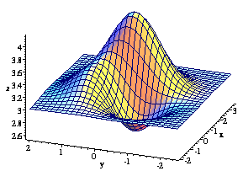
Feed Forward Network
&
Backpropagation
JST 4 - Feed Forward Network & Backpropagation

Slide 2
The History
1962 - Frank Rosenblatt: “Back-propagating error-correction procedures” In Principles of Neurodynamics.
1969 – Marvin Minsky and Seymour Papert: “Perceptrons”, MIT Press.
1974 - Paul Werbos: “Beyond regression: new tools for prediction and analysis in the behavioral sciences” Ph.D. thesis. Harvard University.
1986 - D. E. Rumelhart, G. E. Hinton, and R. J. Williams. “Learning Internal Representations by Error Propagation”, published in Parallel Distributed Processing. volume I and II, by the PDP group of UCSD.
1986- today - the interest about the neural networks is on the rise.
JST 4 - Feed Forward Network & Backpropagation

Slide 3
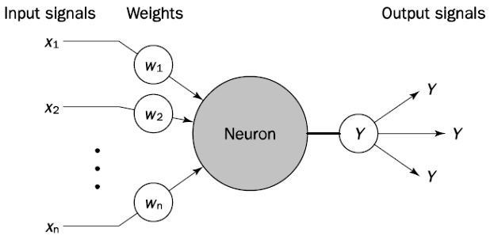
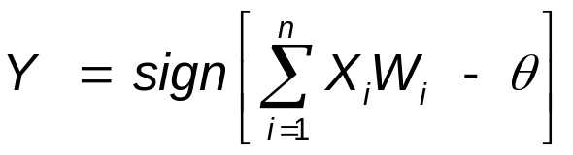
The Neuron Model
JST 4 - Feed Forward Network & Backpropagation

Slide 4
The activation / output function : f(S)
y = f(S)
(sometimes) y = g(S)
The choice of output function f determines the behaviour of the neuron.
Common choices are:
  Step function
  Sign function
  Binary or Bipolar Sigmoid function
  Linier function
  Biologically function : 1 represents a pulse,
  0 represents no pulse.
Threshold is minimum total weighted input necessary for neuron to fire.
JST 4 - Feed Forward Network & Backpropagation

Slide 5
Step Function
y
+1
t
S
f(s) = Y^{step} = +1 if S ≥ θ
0 if S < θ
(θ = Threshold)
JST 4 - Feed Forward Network & Backpropagation

Slide 6
Sign Function
y
+1
S
-1
f(s) = Y^{sign} = +1 if S ≥ 0
-1 if S < 0
JST 4 - Feed Forward Network & Backpropagation

Slide 7
Binary Sigmoid Function
y
+1
S
1
f(s) = Y^{sigmoid} =
1 + e^{-S}
JST 4 - Feed Forward Network & Backpropagation

Slide 8
Bipolar Sigmoid Function
y
+1
S
-1
2
f(s) = Y^{sigmoid} =
- 1
1 + e^{-S}
JST 4 - Feed Forward Network & Backpropagation

Slide 9
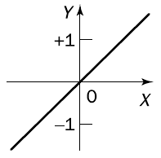
Linier Function
S
f(s) = Y^{linier} = S
JST 4 - Feed Forward Network & Backpropagation

Slide 10
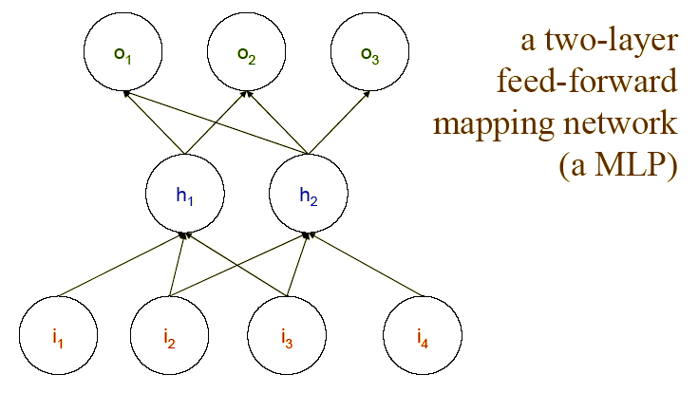
Multilayer Perceptron (Feed-Forward Network)
JST 4 - Feed Forward Network & Backpropagation

Slide 11
A Feed-forward Network
I₁
X₁
H₁
Y₁
O₁
I₂
X₂
H₂
Y₂
O₂
I₃
X₃
X₄
H₃
I₄
Input Layer
Hidden Layer
Output Layer
JST 4 - Feed Forward Network & Backpropagation

Slide 12
A Feed-forward Network
y₁
…
y_{m}
Output Layer
u_{j1}
u_{1m}
u₁₁
u_{l1}
u_{j1}
u_{lm}
b₁
…
b_{l}
…
b_{j}
Hidden Layer
v₁₁
v_{1l}
v_{kl}
v_{il}
v_{ij}
v_{1j}
v_{k1}
v_{kj}
v_{i1}
a₁
…
a_{k}
…
a_{i}
w₁₁
w_{1k}
w_{nk}
w_{ni}
Input Layer
w_{n1}
w_{1i}
x₁
…
x_{n}
JST 4 - Feed Forward Network & Backpropagation

Slide 13
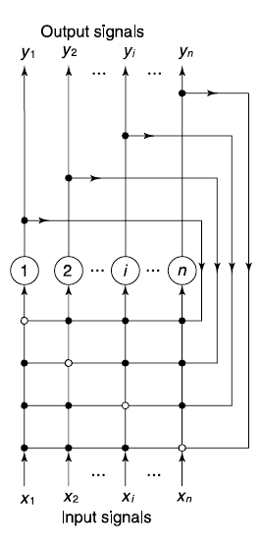
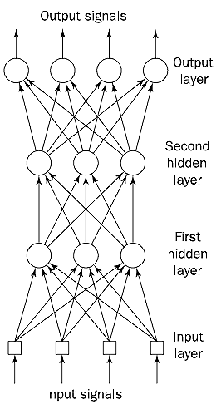
Feed Forward NN vs Recurrent NN
JST 4 - Feed Forward Network & Backpropagation

Slide 14
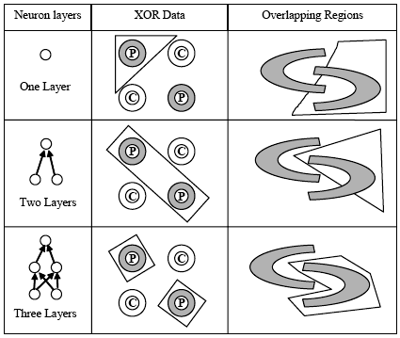
Why do we need a hidden layer?
JST 4 - Feed Forward Network & Backpropagation

Slide 15
Weights to hidden units: how to learn?
“The problem, as noted by Minsky and Papert, is that whereas there is a very simple guaranteed learning rule for all problems that can be solved without hidden units, namely the perceptron convergence procedure, there is no equally powerful rule for learning in networks with hidden units” (Rumelhart, Hinton and Williams; 1986)
The learning rule dened for the perceptron and Adaline update the weights to the output units using the error between the actual output and the desired output. The challenge is:
How do you compute the error for the hidden units??
JST 4 - Feed Forward Network & Backpropagation

Slide 16
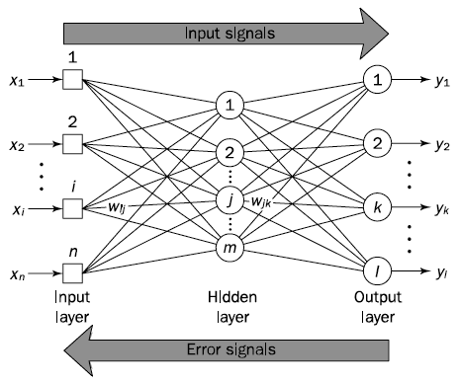
Activation and Error back-propagation
JST 4 - Feed Forward Network & Backpropagation

Slide 17
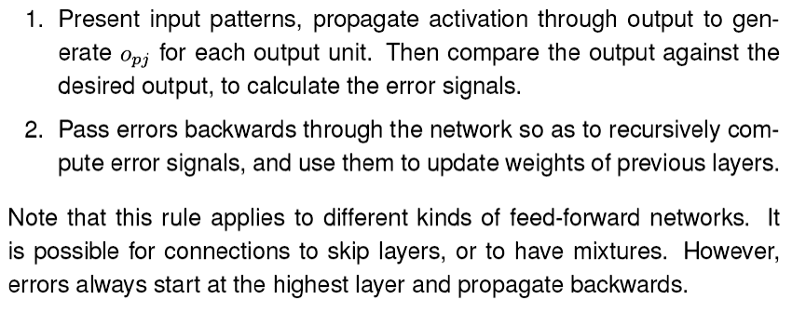
Two phases of Back-Propagation
Y_{k}
JST 4 - Feed Forward Network & Backpropagation

Slide 18
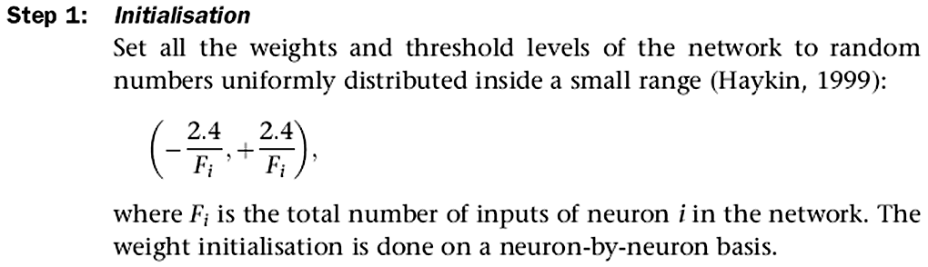
Backpropagation (Phase I) (Negnevitsky, 2005)
JST 4 - Feed Forward Network & Backpropagation

Slide 19
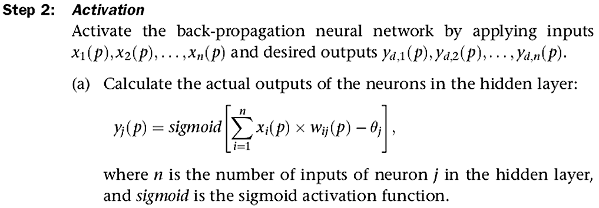
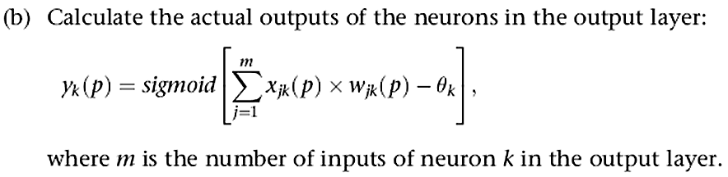
Backpropagation (Phase I) (Negnevitsky, 2005)
JST 4 - Feed Forward Network & Backpropagation

Slide 20
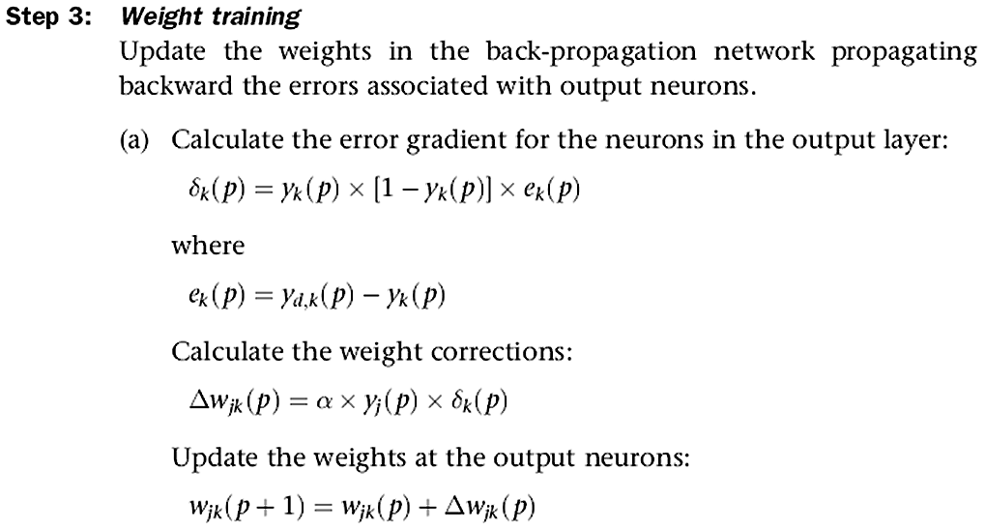
Backpropagation (Phase II) (Negnevitsky, 2005)
JST 4 - Feed Forward Network & Backpropagation

Slide 21
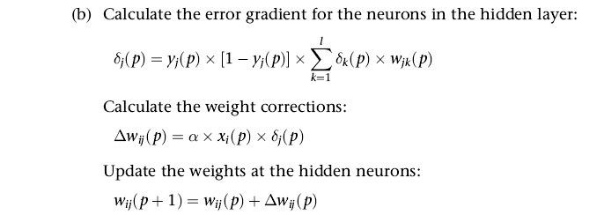

Backpropagation (Phase II) (Negnevitsky, 2005)
JST 4 - Feed Forward Network & Backpropagation

Slide 22
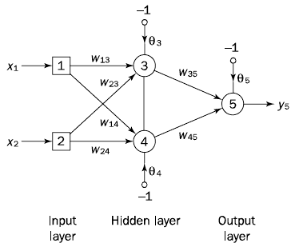
Example
JST 4 - Feed Forward Network & Backpropagation

Slide 23
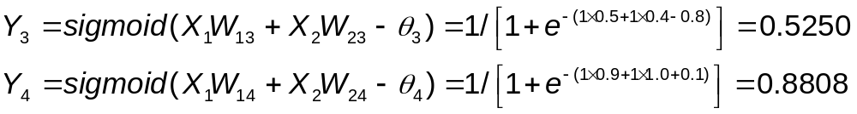
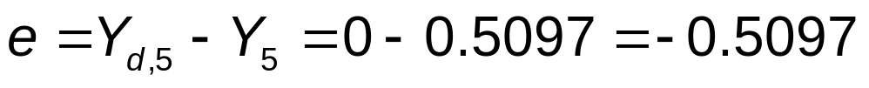
Example
The initial weights and threshold levels are set randomly:
W₁₃ = 0.5 W₂₃ = 0.4 W₃₅ = -1.2
W₁₄ = 0.9 W₂₄ = 1.0 W₄₅ = 1.1
θ₃ = 0.8 θ₄ = -0.1 θ₅ = 0.3
Learning Rate, α = 0.1
Assume: Training Set 1 ⇒ (1, 1) = 0
Step 2a: The actual outputs of neurons 3 and 4 (hidden layer).
Step 2b: The actual outputs of neurons 5 (ouput layer).
Step 3: Output Error
JST 4 - Feed Forward Network & Backpropagation

Slide 24
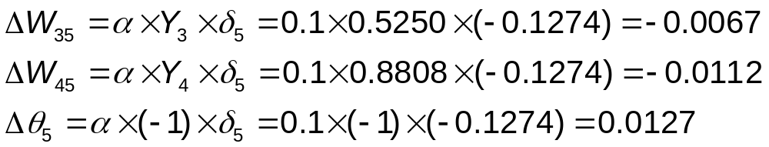
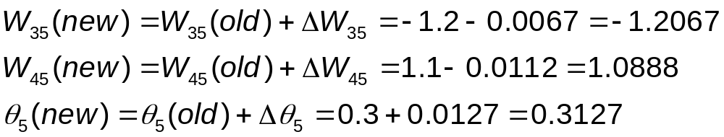
Example
Step 3a: Calculate the error gradient for neuron 5 (output layer):
Calculate the weight corrections.
Update weights of the neuron 5 (output layer):
JST 4 - Feed Forward Network & Backpropagation

Slide 25
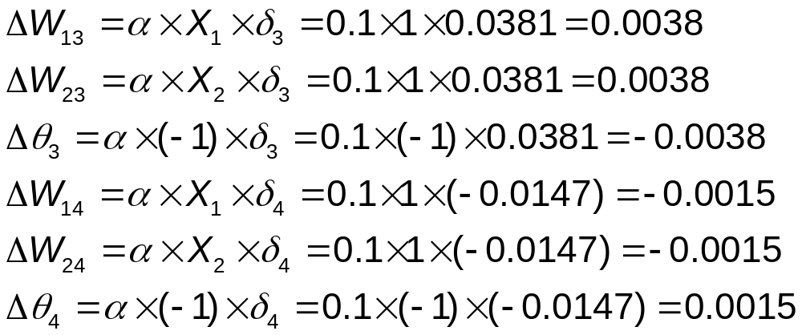
Example
Step 3b: Calculate the error gradients for neurons 3 and 4 (hidden layer):
Calculate the weight corrections.
JST 4 - Feed Forward Network & Backpropagation

Slide 26
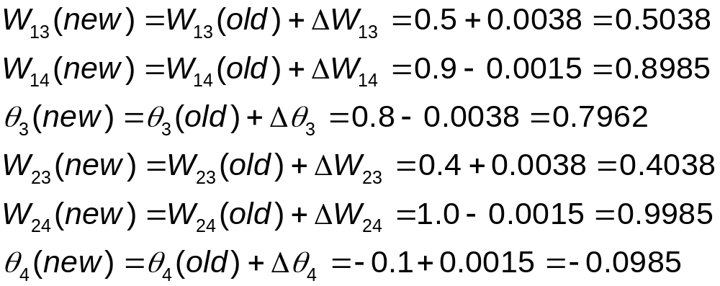
Example
Update weights of the neuron 3 and 4 (hidden layer):
Step 4: The training process is repeated until the sum of squared errors is less than 0.001.
JST 4 - Feed Forward Network & Backpropagation

Slide 27
Example: The Answer
It took 224 epochs or 896 iterations to train the network to perform the Exclusive-OR operation.
Final Weights:
W₁₃ = 4.7621 W₂₃ = 4.7618
W₁₄ = 6.3917 W₂₄ = 6.3917
W₃₅ = 10.3788 W₄₅ = 9.7691
θ₃ = 7.3061 θ₄ = 2.8441
θ₅ = 4.5589
JST 4 - Feed Forward Network & Backpropagation

Slide 28
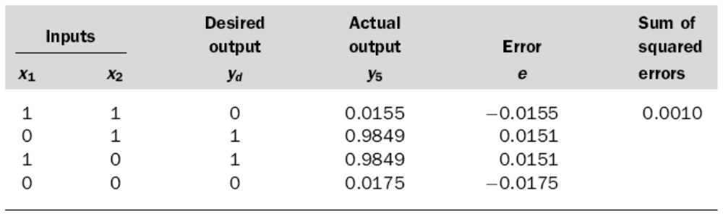
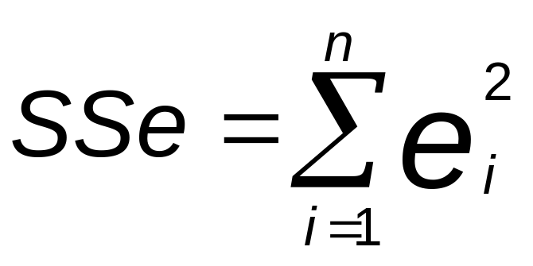
Error Criterion Threshold
(Sum of Squared Error)
JST 4 - Feed Forward Network & Backpropagation

Slide 29
Why do we need a hidden layer?
JST 4 - Feed Forward Network & Backpropagation

Slide 30

Accelerated Learning
Hyperbolic Tangent:
where a and b are constants.
Suitable values for a and b are: a = 1.716 and b = 0.667
(Guyon, 1991).
Momentum Term:
in the delta rule (Rumelhart et al., 1986)
where β is a positive number (0 ≤ β < 1) called the momentum constant. Typically, β = 0.95.
JST 4 - Feed Forward Network & Backpropagation

